Slide 1

AI Engineer Agentic Track
The Complete
Agent & MCP
Course
Week 1
Day 4

Slide 2
Week 6: MCP
Agentic
Architecture
and MCP
Building an
MCP Server
and Client
Multiple Local
and Remote
MCP servers
Project 8: AI
Equity Traders
Project 8: AI
Equity Traders
In Action
Week 5: Agent Frameworks
Google ADK and A2A
AWS Strands Agents
Other Python Frameworks
JS/TS Frameworks
Project 7:
Agent
Loop
Week 4: LangGraph
Understand
LangGraph
concepts
Build a
LangGraph
Agent
Tools, memory,
web searches
Project 6:
Sidekick
Project 6:
Sidekick
improvements
Week 3: CrewAI
Understand
Crew AI
Concepts
Build a Crew
Agent
Project 4: Stock
Picker
Project 5:
Developer
Agent
Project 5:
Engineering
Team
Week 2: OpenAI Agents SDK
Understand
OpenAI Agents
SDK concepts
Project 2: an
SDR
Tools vs Agents
Guardrails
Project 3: Deep
Research
Project 3: Deep
Research app
Week 1: Foundations
Make an
Agentic
Workflow
Agents and
Agentic
Patterns
Orchestrating
LLMs
Autonomy and
Tools
Project 1:
Your personal
career agent

Slide 3
The Agent Landscape
Different types of offering related to AI Agents
Builders
Products
Runtimes
Frameworks
Non-technical people can
build AI Agents
Non-technical people can
use AI Agents
Technical people can
execute AI Agents
Technical people can
develop AI Agents
n8n
Claude Code
AWS Lambda
OpenAI Agents SDK
ElevenLabs
Cowork
AWS Bedrock AgentCore
CrewAI
OpenAI Agent Builder
OpenClaw
Claude Managed Agents
LangGraph / LangChain
LangGraph
CrewAI Studio
Claude Design
Vertex AI Agent Engine
Google ADK
AI Builder
AI Coder
AI Engineer
Production Track
AI Engineer
Agentic Track
No framework

Slide 4
Agent Frameworks
Helper code that makes it easier to create Agents based on LLM calls
Orchestration - chaining together LLM calls
Tool calling - equipping an LLM with abilities, including with MCP
Constructing LLM inputs and interpreting outputs - including a technique called ‘Structured Outputs’
This allows you to easily code an ‘Agent Loop’ -
an LLM in a loop with tools to achieve a goal

Slide 5
Agent Frameworks
CrewAI
LangGraph / LangChain
OpenAI Agents SDK
Google
ADK
AWS Strands Agents
No framework
Many more! By the end, I will tell you how to pick the right one for your project

Slide 6
"Tools" give LLMs abilities
The power to carry out actions like
query a database or look up stock prices
Sounds spooky, right? OpenAI
can reach into my computer? A large language model generates tokens -what makes it suddenly decide to run code on my computer?
The reality is a bit mundane

Slide 7
Tool Calling - in theory
An LLM Equiped with a tool seems magical
User
Software
LLM
Tools
Search the internet
Query a database
Edit a Google Sheet
Look up stock prices

Slide 8
Tool Calling - in practice
The reality is more mundane
User
Software
LLM
Tools
Search the internet
Query a database
Edit a Google Sheet
Look up stock prices

Slide 9
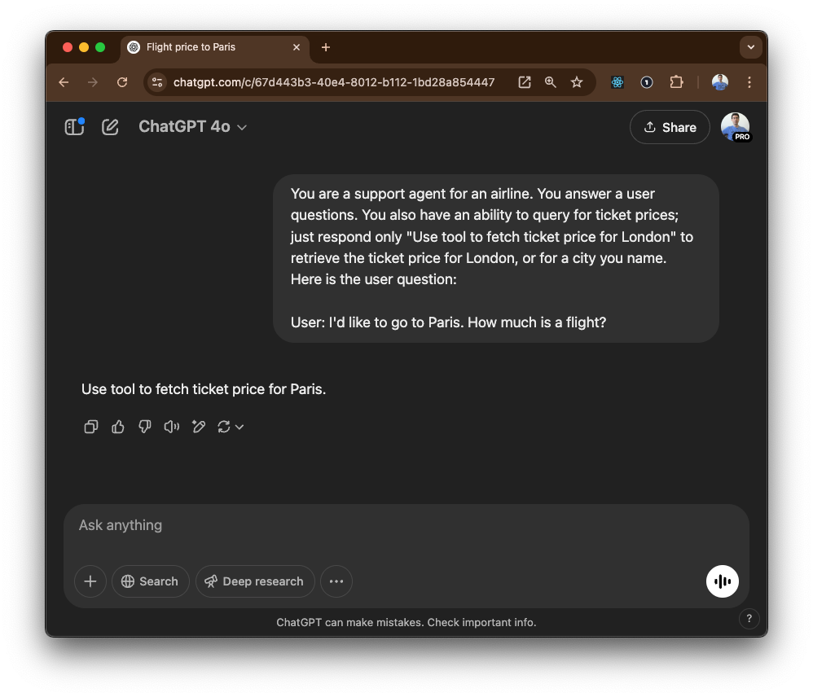
Behold Tool use.

Slide 10
The Agent Loop Feels Like This
Software
LLM
Tools
• Search the internet
• Query the database
• Run some code

Slide 11
The Agent Loop Is Actually This
Software
LLM
Tools
• Search the internet
• Query the database
• Run some code

Slide 12


Slide 13
Summary
Agentic AI involves building a harness around LLMs, crafting the inputs and interpreting the outputs, in a loop, so that they can ‘use tools’ and ‘be autonomous’
Agent Frameworks are helper code that make it faster to implement these techniques, but they’re not required
By the end of this course, you will be able to deliver significant commercial value by building autonomous AI Agents

Slide 14
Week 6: MCP
Agentic
Architecture
and MCP
Building an
MCP Server
and Client
Multiple Local
and Remote
MCP servers
Project 8: AI
Equity Traders
Project 8: AI
Equity Traders
In Action
Week 5: Agent Frameworks
Google ADK and A2A
AWS Strands Agents
Other Python Frameworks
JS/TS Frameworks
Project 7:
Agent
Loop
Week 4: LangGraph
Understand
LangGraph
concepts
Build a
LangGraph
Agent
Tools, memory,
web searches
Project 6:
Sidekick
Project 6:
Sidekick
improvements
Week 3: CrewAI
Understand
Crew AI
Concepts
Build a Crew
Agent
Project 4: Stock
Picker
Project 5:
Developer
Agent
Project 5:
Engineering
Team
Week 2: OpenAI Agents SDK
Understand
OpenAI Agents
SDK concepts
Project 2: an
SDR
Tools vs Agents
Guardrails
Project 3: Deep
Research
Project 3: Deep
Research app
Week 1: Foundations
Make an
Agentic
Workflow
Agents and
Agentic
Patterns
Orchestrating
LLMs
Autonomy and
Tools
Project 1:
Your personal
career agent

Slide 15

AI Engineer Agentic Track
The Complete
Agent & MCP
Course
13%
Complete

